Slide 1
Fundamentals of Programming
Arrays

Slide 2
Introduction
Suppose you need to input 100 numbers and compute their average…
Will you declare 100 variables?
Then write cin statement 100 times to input values for 100 variables?
Writing a code this way would be impractical… what if you have to input 10000 numbers instead of 100….
Solution is to use Arrays…
A single array can store a large collection of data
An array is used to store multiple values of the same type.
An element in an array can be accessed using an index.

Slide 3
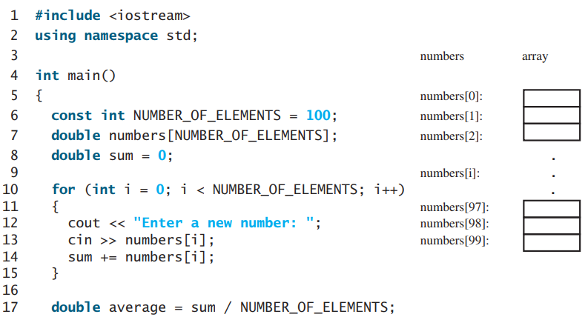
Introduction
program declares an array of 100 elements in line 7
stores numbers into the array in line 13
adds each number to sum in line 14, and obtains the average in line 17

Slide 4
Array Basics
Declaring Arrays: specify its element type and size as
elementType arrayName[SIZE]; double myList[10];
The compiler allocates the space for ten
The compiler allocates the space for 10 double elements for array myList
When an array is declared, its elements are assigned arbitrary values
To assign value to an element of array, use its index and assignment operator as
myList[0] = 10;
myList[5] = 2;

Slide 5
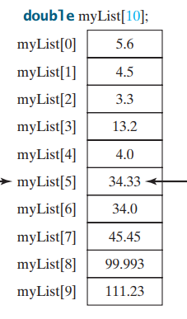
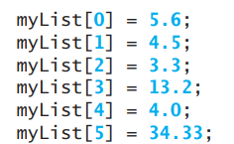
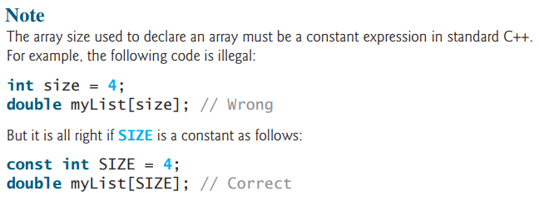
Array Basics

Slide 6
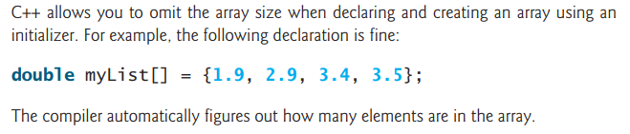
Array Basics
Other arithmetic operators can be applied to array elements just like the assignment operator
double x = myList[0] + myList[4];
bool z = myList[3] > myList[1];
Array Initializers
declares and initializes anarray in a single statement as
double myList[4] = {1.9, 2.9, 3.4, 3.5};

Slide 7
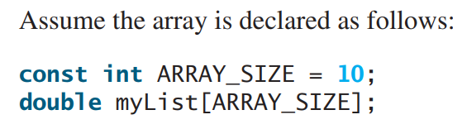
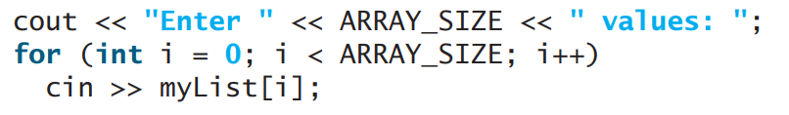
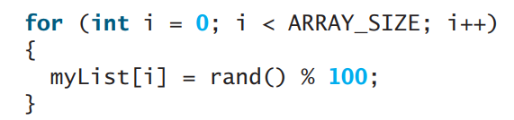
Array Basics
Initialing arrays with input values
Initializing arrays with random values

Slide 8
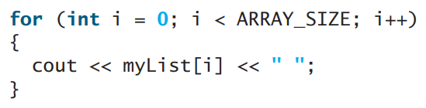
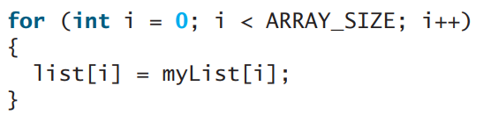
Array Basics
Printing arrays
Copying arrays
double list = myList; // is not allowed
You must copy individual elements from one array to other

Slide 9
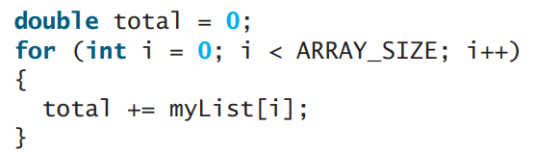
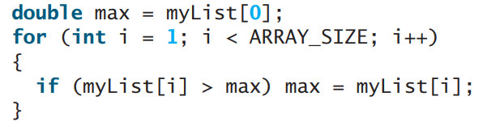
Array Basics
Summing all elements
Finding the largest element

Slide 10
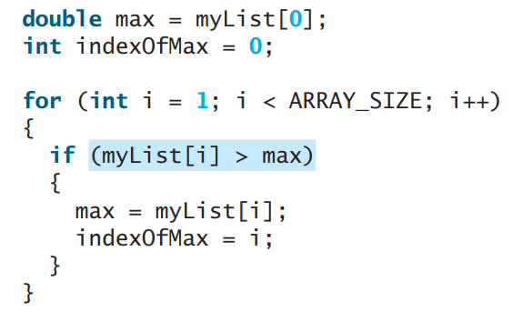
Array Basics
Finding the smallest index of the largest element

Slide 11
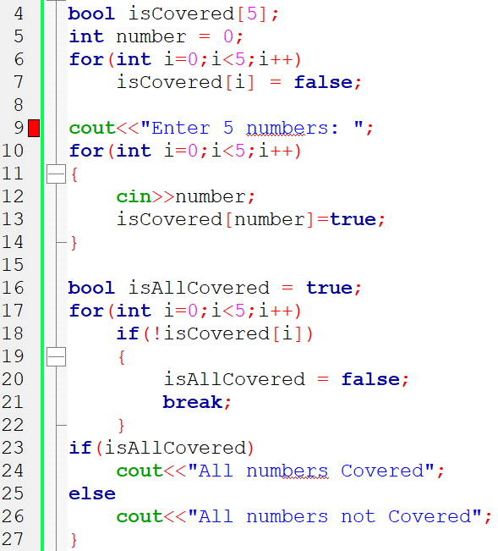
Array Basics
Ask user to enter 5 numbers, then display either user has entered all 5 numbers from 0 to 4 or not. (use Arrays)

Slide 12
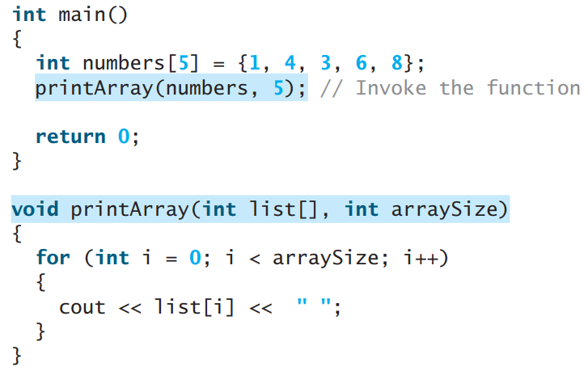
Passing Arrays to Functions
Just as you can pass single values to a function, you also can pass an entire array to a function

Slide 13
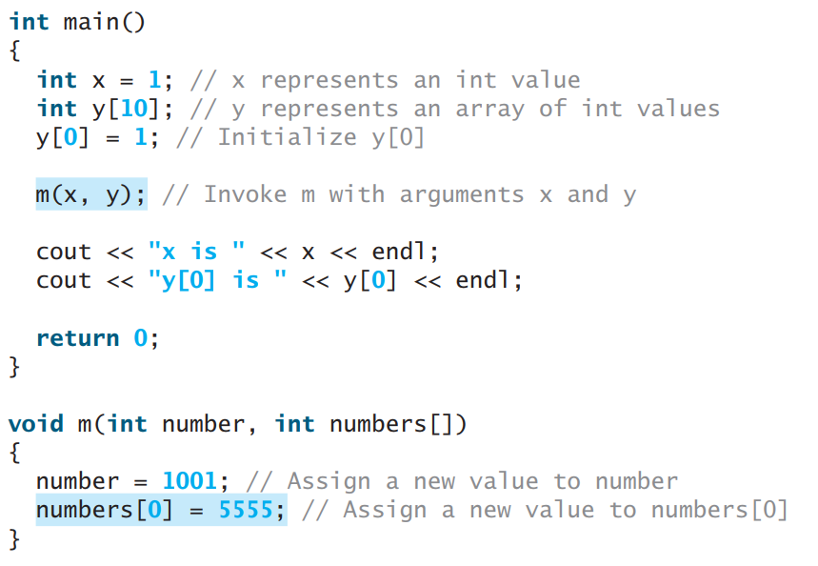
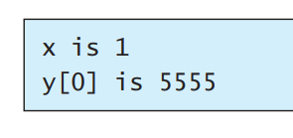
Passing Arrays to Functions
When an array argument is passed to a function, its starting address is passed to the array parameter in the function. Both parameter and argument refer to the same array.

Slide 14
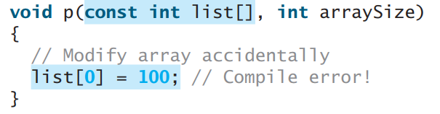

Passing Arrays to Functions
You can define const array parameter in a function to prevent it from being changed in a function.
To return an array from a function, pass it as a parameter in a function.
This is not allowed, instead, pass another array to store reverse values

Slide 15
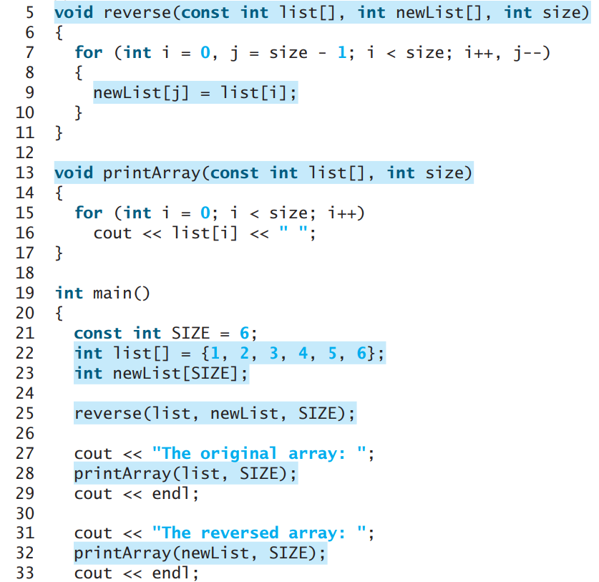
Passing Arrays to Functions

Slide 16
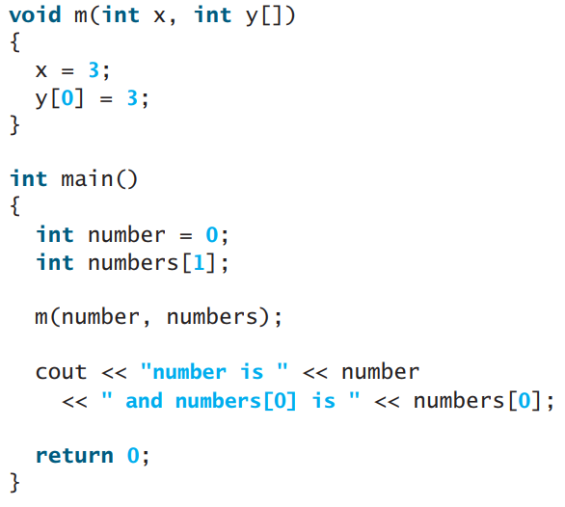
Output?

Slide 17
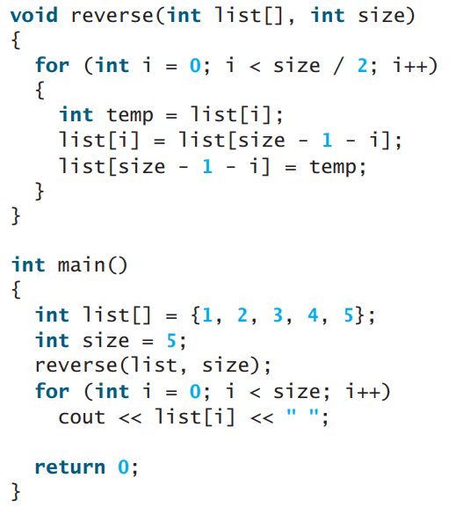
Output?

Slide 18
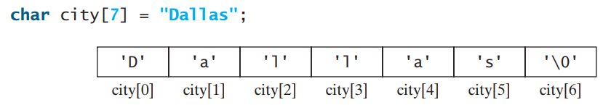
C-Strings
C-string is an array of characters that ends with the null terminator character '\0'.
You can process C-strings using C-string functions in the C++ library.
The first statement is a C-string and the second statement is just an array of characters.
The former has 7 characters including the last null terminator and the latter has 6 characters.

Slide 19
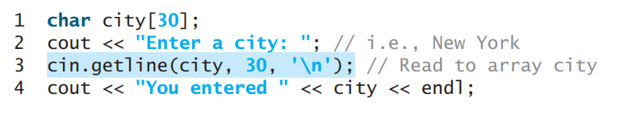
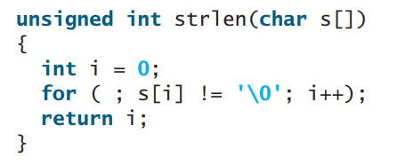
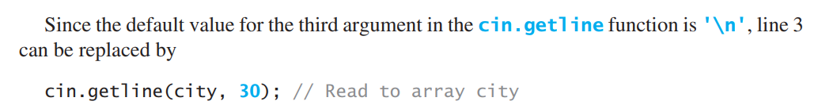
C-Strings

Slide 20
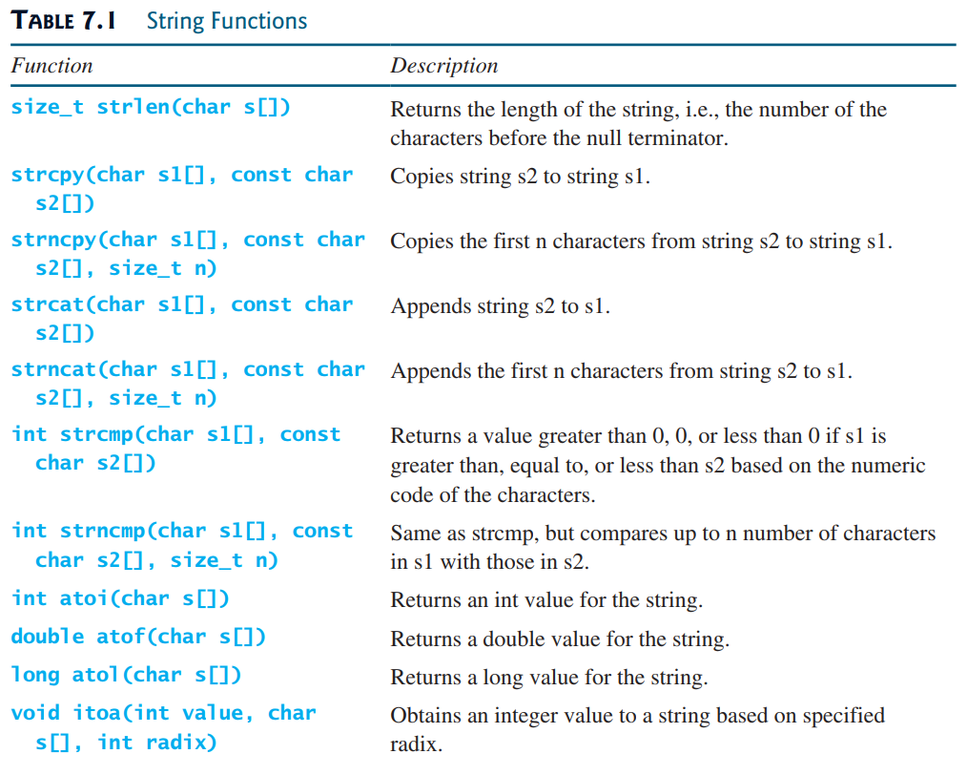
C-Strings

Slide 21
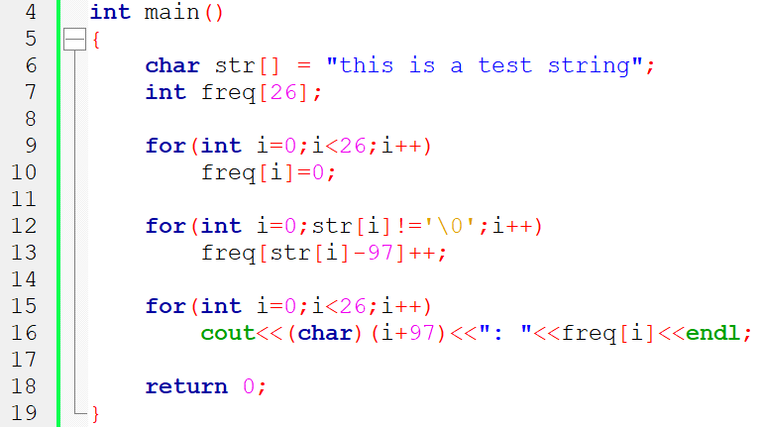
C-Strings
Write a function to count frequency of letters in a C-String.

Slide 22
Thanks

